Slide 1
Stem Cutting Propagation of Aromi Hybrid Deciduous Azaleas
Yongli Zhao, Zheran Wang
STAT6110 Dr. Philippe Gaillard
Group Project

Slide 2
CONTENTS
Introduction
Procedures and Methods
Results
Discussion and Conclusion
Reference

Slide 3
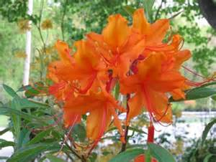
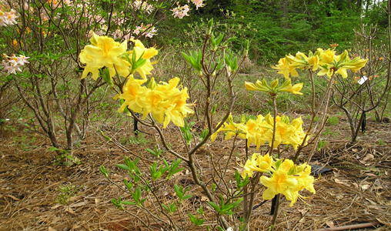
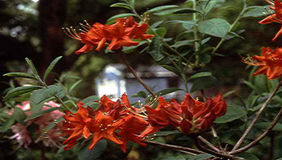
INTRODUCTION
This experiment was done by Heath Gober.
Aromi series are new hybrid azaleas between the Exbury azaleas and native Southeastern United States species. They have fragrance and more color combinations in flowers, larger blooms, greater heat tolerance, and also prefer an acidic, moist, and well-drained soil.(1,2)
K-IBA: (potassium salt of indole butyric acid, the rooting hormone) is the recommended form of IBA for propagating deciduous azaleas (3).
‘Great Balls of Fire’
(orange)
‘Lemonade’
(yellow)
‘Radiant Red’
(red)

Slide 4
INTRODUCTION
Prior research conducted propagating deciduous azaleas gives conflicting results regarding K-IBA concentrations.
Maarten van der Geissen, stated that using a 2500 ppm solution provided the most favorable results for most Aromi azaleas.
Dirr and Hueser state that 4000 ppm is the ideal concentration for U.S. native species, and Knight concluded that a concentration of 7500 ppm is the recommended K-IBA concentration for Aromi parent plants Rhododendron austrinum and R. canescens (4, 5).

Slide 5
INTRODUCTION
Goals
Analyzing the relationship between the concentration of K-IBA and the number of the rooted cuttings among the Aromi collection.
Significance to the Nursery Industry

Slide 6
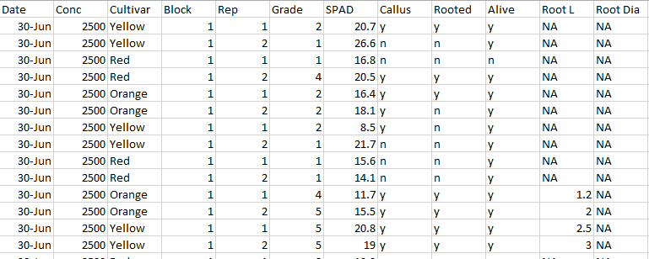
INTRODUCTION
Concentration K-IBA (2500,3750,5000,6250,7500,8750,10000 ppm)
Rooted
Y: present rooted
N: present no rooted.

Slide 7
Procedures and Methods
First, summary the data using frequency table in order to get the number of rooted cutting under seven different levels of concentration of K-IBA.
Second, analyze the relationship between the number of the rooted cutting and the concentration of K-IBA using simple linear regression analysis.

Slide 8
Procedures and Methods
Simple Linear Regression Analysis
Independent variable (continuous): concentration of K-IBA with seven levels measured in PPM.
Dependent variable (continuous): the number of the rooted cutting.
Model: y=β0+β1x
F-test for linear association:(Is there any linear associate in between the independent and dependent variables?)
H0: β1=0, Ha: β1≠0

Slide 9
RESULTS
Frequency Table of Rooted by Concentration
Rooted | Concentration
 | 2500 | 3750 | 5000 | 6250 | 7500 | 8750 | 10000 | Total
0 (“n”) No rooted | 49 | 48 | 50 | 43 | 47 | 42 | 28 | 307
 | 15.96 | 15.64 | 16.29 | 14.01 | 15.31 | 13.68 | 9.12
1(“y”) Rooted | 59 | 60 | 58 | 65 | 61 | 66 | 80 | 449
 | 13.14 | 13.36 | 12.92 | 14.48 | 13.59 | 14.7 | 17.82
Total | 108 | 108 | 108 | 108 | 108 | 108 | 108 | 756
*Top line represent the frequency
Bottom line represent the Row Percentage

Slide 10
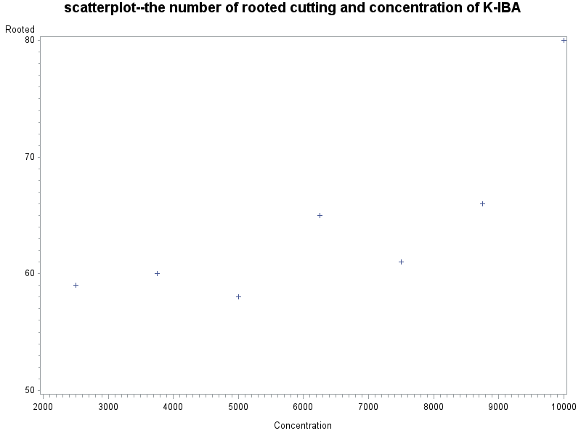
RESULTS
Do they have linear relationship?

Slide 11
RESULTS
F-test for linear association:( Is there any linear associate in between the independent and dependent variables?)
H0: they don’t linear relationship---β1=0
Ha: they do have linear relationship---β1≠0
a= 0.05 in this case
Analysis of Variance
Source | DF | Sum of Squares | Mean Square | F Value | Pr > F
Model | 1 | 217.286 | 217.286 | 8.38 | 0.034
Error | 5 | 129.571 | 25.9143
Corrected Total | 6 | 346.857
P-value is 0.034, less than 0.05, reject the H0.
Claim that they have linear relationship

Slide 12
RESULTS
Parameter Estimates
Variable | DF | Parameter Estimate | Standard Error | t Value | Pr > |t| | 95% Confidence Limits
Intercept | 1 | 50.2143 | 5.18071 | 9.69 | 0.0002 | 36.8968 | 63.5317
Concentration | 1 | 0.00223 | 0.00077 | 2.9 | 0.034 | 0.00025 | 0.00421
less than 0.05, which reject H0: β0=0 (the regression lines go through the origin) and accept Ha: the linear regression line doesn’t pass the origin—β0≠0
The fitted regression function can write: if Y= the number of the rooted cutting
Y=50.2143+0.00223 * x (x= the concentration of K-IBA).

Slide 13
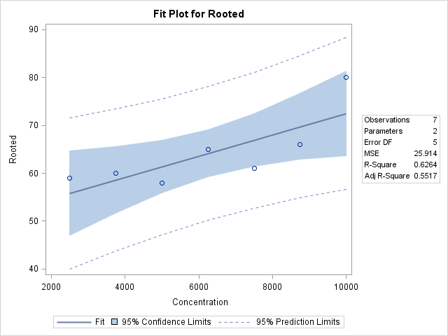
RESULTS

Slide 14
Discussion and Conclusion
There exists a linear relationship between the concentration (K-IBA) and the number of rooted cutting.
However, the coefficient of determination (R-square) is only .6264, which means roughly 62.64% of the total variation in the response can be explained by this linear model. The relationship between them is not very tight based on Heath Gober’s experiment data.

Slide 15
Reference
1.Dirr, M.A. 2009. Manual of Woody Landscape Plants: Their Identification, Ornamental Characteristics, Culture, Propagation and Uses. 6th ed. Stipes Publishing, Champaign, Illinois.
2.Finch, B. 2002. The Aromi Azaleas. J. Amer. Rhododendron Soc. Accessed July 11, 2016. http://scholar.lib.vt.edu/ejournals/JARS/v56n1/v56n1-finch.htm
3.Galle, F.C. 1987. Azaleas: Revised and Enlarged Edition. Timber Press, Portland, OR.
4.Dirr. M.A. and C. W. Hueser, Jr. 2006. The Reference Manual of Woody Plant Propagation: From Seed to Tissue Culture. 2nd ed. Timber Press, Portland, OR.
5.Knight, P.R and C. Coker. 2005. Mist interval and K-IBA concentration influence rooting of orange and mountain azalea. Native Plant J. 6(2):111-117.

Slide 16


